Slide 1


Understanding the Difficulty of Training Transformers
Liyuan Liu, Xiaodong Liu, Jianfeng Gao, Weizhu Chen, Jiawei Han
EMNLP 2020
김봉민

Slide 2
Introduction

Slide 3

Part 1
Introduction
Transformers have led to a series of breakthroughs in various deep learning tasks.
effectiveness, efficiency, and scalability.
Training Transformers, however, requires extra efforts
SGD -> RNNs and CNNs, SGD -/-> bad/suspicious local optima for Transformers.
Removing the warmup stage in Transformer training -> model divergence.
* What complicates Transformer training.

Slide 4
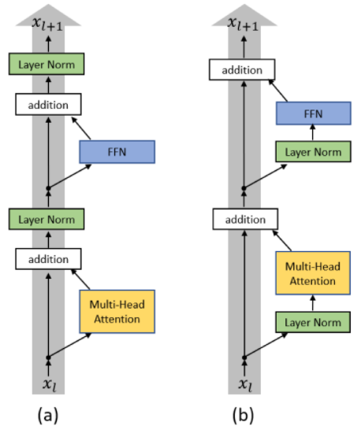
Part 1
Introduction
Our analysis starts from the observation: the original Transformer (referred to as Post-LN) is less robust than its Pre-LN variant.
We recognize that gradient vanishing issue is not the direct reason causing such difference, since fixing this issue alone cannot stabilize Post-LN training.
It implies that, besides unbalanced gradients, there exist other factors influencing model training greatly.
Post-LN
Pre-LN

Slide 5
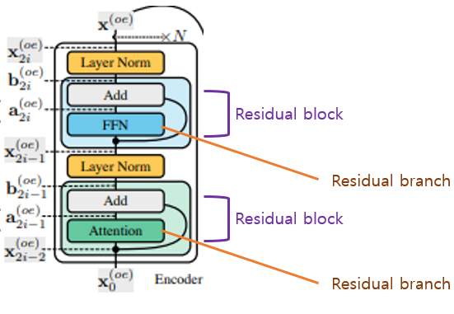
Part 1
Introduction
With further analysis, we recognize that for each Transformer residual block, the dependency on its residual branch plays an essential role in training stability.
First, we find that a Post-LN layer has a heavier dependency on its residual branch than a Pre-LN layer.
Second, we find that strong dependencies of Post-LN amplify fluctuations brought by parameter changes and destabilize the training.
Besides, the loose reliance on residual branches in Pre-LN generally limits the algorithm’s potential and often produces inferior models.
Residual branch의 의존성이 중요! -> 의존성이 크면(post ln) 학습 불안정, 작으면(pre ln) 잠재 능력 하락
For a residual block $x+f(x)$, its shortcut output refers to $x$, its residual branch output refers to $f(x)$, and the dependency on its residual branch refers to $\frac{Var[f\left(x\right)]}{Var[x+f\left(x\right)]}$.

Slide 6
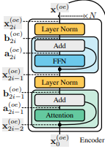
Part 1
Introduction
Residual output
Residual block
Residual branch
Residual output
Residual block
Residual branch
For a residual block $x+f(x)$, its shortcut output refers to $x$, its residual branch output refers to $f(x)$, and the dependency on its residual branch refers to $\frac{Var[f\left(x\right)]}{Var[x+f\left(x\right)]}$.

Slide 7
Part 1
Introduction
In light of our analysis, we propose Admin, an adaptive initialization method which retains the merits of Pre-LN stability without hurting the performance.
It restricts the layer dependency on its residual branches in the early stage and unleashes the model potential in the late stage.
We conduct experiments on IWSLT’14 De-En, WMT’14 En-De, and WMT’14 En-Fr

Slide 8
Preliminaries
김봉민

Slide 9
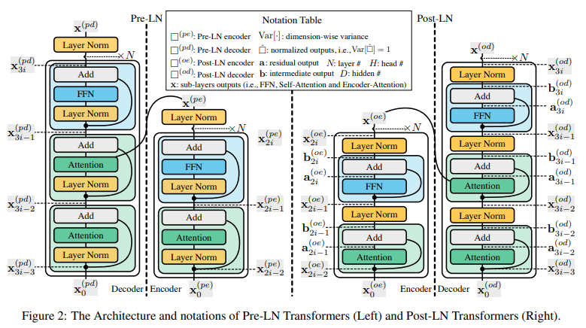
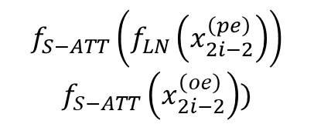
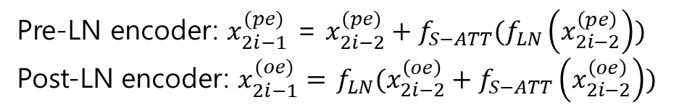
Part 2
Preliminaries
Pre-LN encoder: $x_{2i−1}^{(pe)}$ = $x_{2i−2}^{(pe)}+f_{S−ATT}(f_{LN}\left(x_{2i−2}^{\left(pe\right)}\right))$
Post-LN encoder: $x_{2i−1}^{(oe)}=$ $f_{LN}(x_{2i−2}^{\left(oe\right)}+f_{S−ATT}\left(x_{2i−2}^{\left(oe\right)}\right))$
$$f_{S−ATT}\left(f_{LN}\left(x_{2i−2}^{\left(pe\right)}\right)\right)$$
$$f_{S−ATT}\left(x_{2i−2}^{\left(oe\right)}\right))$$
as the residual branches and their outputs as the residual outputs.

Slide 10
Unbalanced Gradients
김봉민

Slide 11
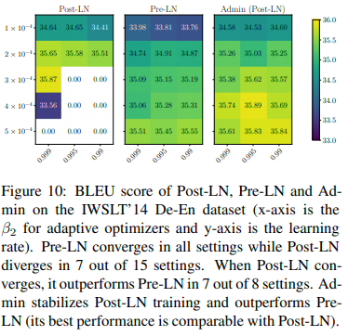
Part 3
Unbalanced Gradients
Our analysis starts from the observation: Pre-LN training is more robust than Post-LN, while Post-LN is more likely to reach a better
performance than Pre-LN.
We seek to reveal the underlying factor that destabilizes Post-LN training and restricts the performance of Pre-LN

Slide 12
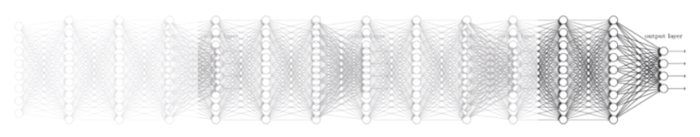
Part 3
Unbalanced Gradients
In this section, we focus on the unbalanced gradients (e.g., gradient vanishing).
We find that, although Post-LN suffers from gradient vanishing and Pre-LN does not, gradient vanishing is not the direct reason causing the instability of Post-LN.

Slide 13
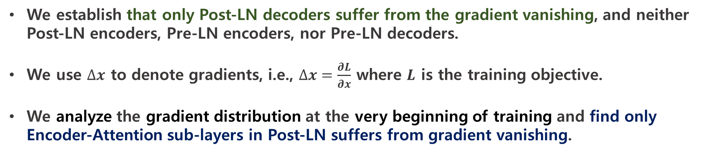
Part 3.1
Gradients at Initialization
We establish that only Post-LN decoders suffer from the gradient vanishing, and neither Post-LN encoders, Pre-LN encoders, nor Pre-LN decoders.
We use $∆x$ to denote gradients, i.e., $∆x=\frac{∂L}{∂x}$ where $L$ is the training objective.
We analyze the gradient distribution at the very beginning of training and find only Encoder-Attention sub-layers in Post-LN suffers from gradient vanishing.

Slide 14
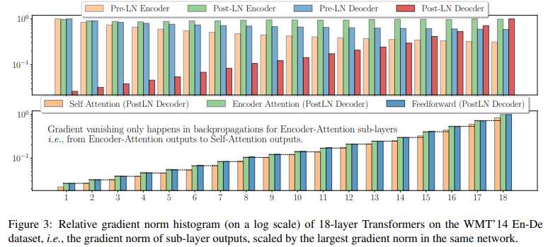
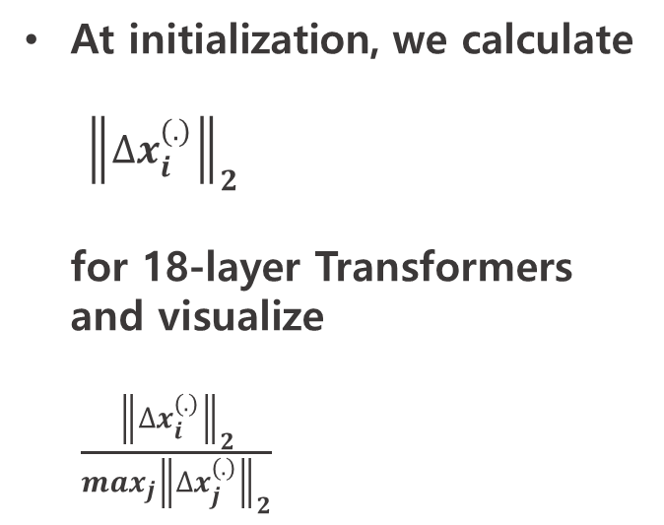
Part 3.1
Gradients at Initialization
At initialization, we calculate ${\left\|∆x_{i}^{(.)}\right\|}_{2}$ for 18-layer Transformers and visualize
$\frac{{\left\|∆x_{i}^{(.)}\right\|}_{2}}{\max_{j}{\left\|∆x_{j}^{(.)}\right\|}_{2}}$
It verifies that only Post-LN decoders suffer from the gradient vanishing.

Slide 15
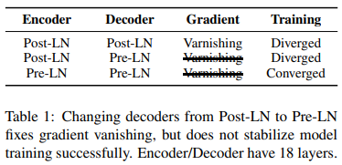
Part 3.2
Impact of the Gradient Vanishing
Now, we explore whether gradient vanishing is the direct cause of training instability
A controlled experiment
This hybrid Transformer does not suffer from gradient vanishing.
Fixing gradient vanishing alone (i.e., changing Post-LN decoders to Pre-LN decoders) fails to stabilize model training.
This observation provides evidence supporting that the gradient vanishing issue is not the direct cause of unstable Post-LN training.

Slide 16
Instability from Amplification Effect
김봉민

Slide 17
Part 4
Instability from Amplification Effect
We find that unbalanced gradients are not the root cause of the instability of Post-LN, which implies the existence of other factors influencing model training.
We examine the difference between Pre-LN and Post-LN, including their early-stage and late-stage training.
Then, we show that Post-LN’s training instability is attributed to layer dependency’s amplification effect, which intensifies gradient updates and destabilizes training.
Post-LN 의 불안정성 -> layer 의존성 증폭 효과로 부터 생겼다!

Slide 18
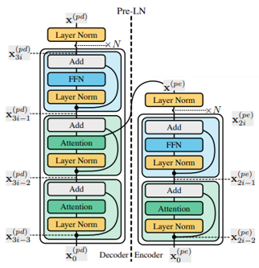
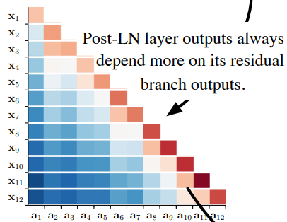
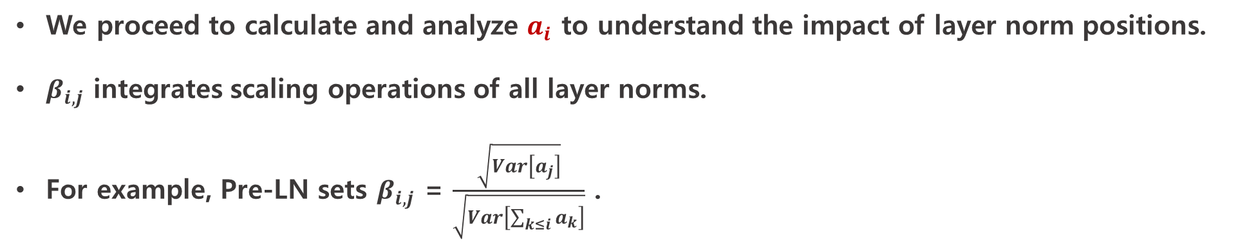

Part 4.1
Impact of Layer Norms Positions
We proceed to calculate and analyze $a_{i}$ to understand the impact of layer norm positions.
$β_{i,j}$ integrates scaling operations of all layer norms.
For example, Pre-LN sets $β_{i,j}$ = $\frac{\sqrt{Var\left[a_{j}\right]}}{\sqrt{Var\left[\sum_{k≤i}{a_{k}}\right]}}$ .
$$a_{i}$$

Slide 19
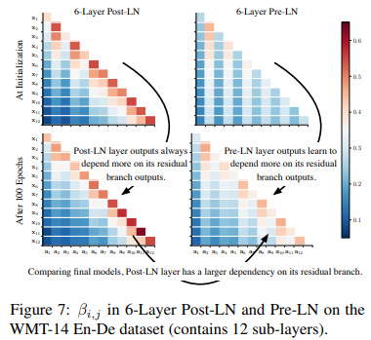
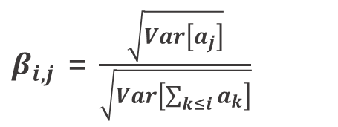
Part 4.1
Impact of Layer Norms Positions
For a Post-LN layer, its outputs rely more on its residual branch from the initialization to the end.
At initialization, Pre-LN layer outputs have roughly the same reliance on all previous residual branches.
However, comparing to Post-LN, Pre-LN layer outputs in the final model still has less reliance on their residual branches.
$β_{i,j}$ = $\frac{\sqrt{Var\left[a_{j}\right]}}{\sqrt{Var\left[\sum_{k≤i}{a_{k}}\right]}}$

Slide 20
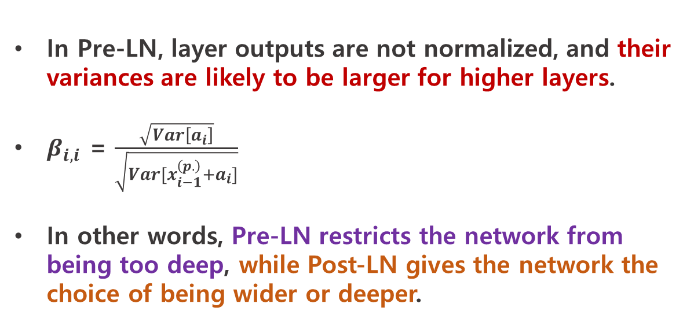
Part 4.1
Impact of Layer Norms Positions
In Pre-LN, layer outputs are not normalized, and their variances are likely to be larger for higher layers.
$β_{i,i}$ = $\frac{\sqrt{Var\left[a_{i}\right]}}{\sqrt{Var[x_{i−1}^{\left(p.\right)}+a_{i}]}}$
In other words, Pre-LN restricts the network from being too deep, while Post-LN gives the network the choice of being wider or deeper.

Slide 21
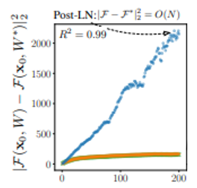

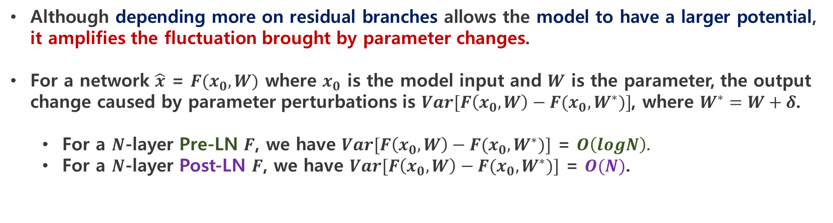
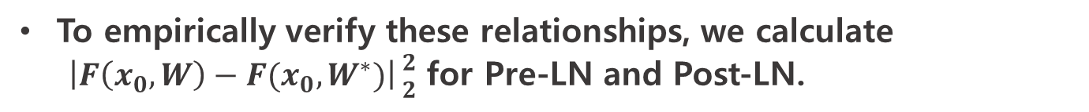
Part 4.2
Amplification Effect at Initialization
Although depending more on residual branches allows the model to have a larger potential, it amplifies the fluctuation brought by parameter changes.
For a network $\hat{x}$ = $F(x_{0}, W)$ where $x_{0}$ is the model input and $W$ is the parameter, the output change caused by parameter perturbations is $Var[F\left(x_{0}, W\right)−F(x_{0}, W^{∗})]$, where $W^{∗}=W+δ$.
For a $N$-layer Pre-LN $F$, we have $Var[F\left(x_{0}, W\right)−F(x_{0}, W^{∗})]$ = $O\left(logN\right).$
For a $N$-layer Post-LN $F$, we have $Var[F\left(x_{0}, W\right)−F(x_{0}, W^{∗})]$ = $O(N)$.
To empirically verify these relationships, we calculate $\left|F\left(x_{0}, W\right)−F(x_{0}, W^{∗})\right|{2 \atop 2}$ for Pre-LN and Post-LN.

Slide 22
Part 4.2
Amplification Effect at Initialization
Intuitively, large output shifts would destabilize the training.
Therefore, we conjecture it is the large output shift of Post-LN results in unstable training.
We proceed to stabilize Post-LN by controlling the dependency on residual branches in the early stage of training.

Slide 23
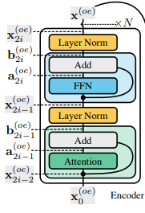



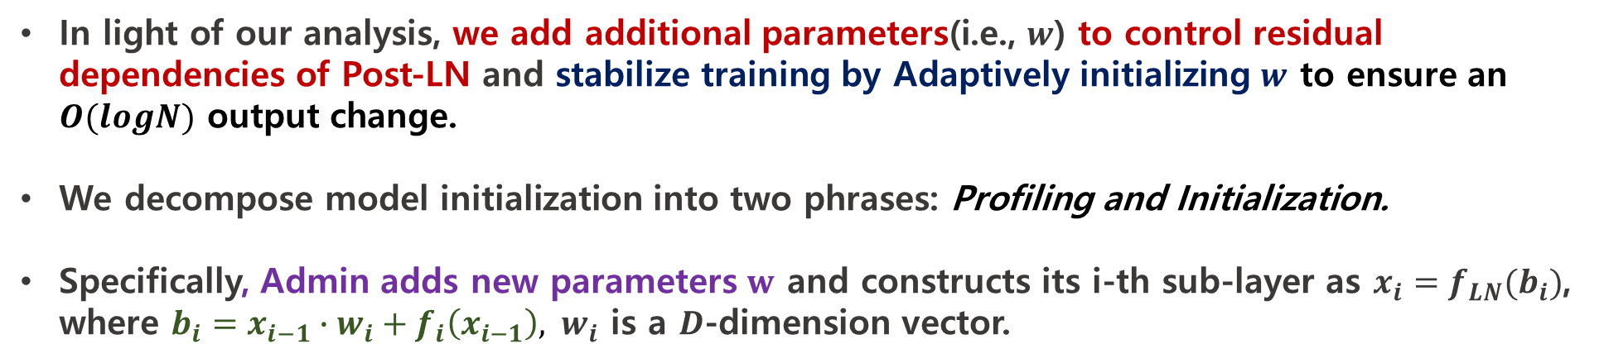
Part 4.3
Admin – Adaptive Model Initialization
In light of our analysis, we add additional parameters(i.e., $w$) to control residual dependencies of Post-LN and stabilize training by Adaptively initializing $w$ to ensure an $O(logN)$ output change.
We decompose model initialization into two phrases: Profiling and Initialization.
Specifically, Admin adds new parameters $w$ and constructs its i-th sub-layer as $x_{i}=f_{LN}(b_{i})$, where $b_{i}=x_{i−1}∙w_{i}+f_{i}\left(x_{i−1}\right), { w}_{i}$ is a $D$-dimension vector.
$$x_{i−1}∙w_{i}$$
$$b_{i}=$$
$$f_{i}\left(x_{i−1}\right)$$

Slide 24
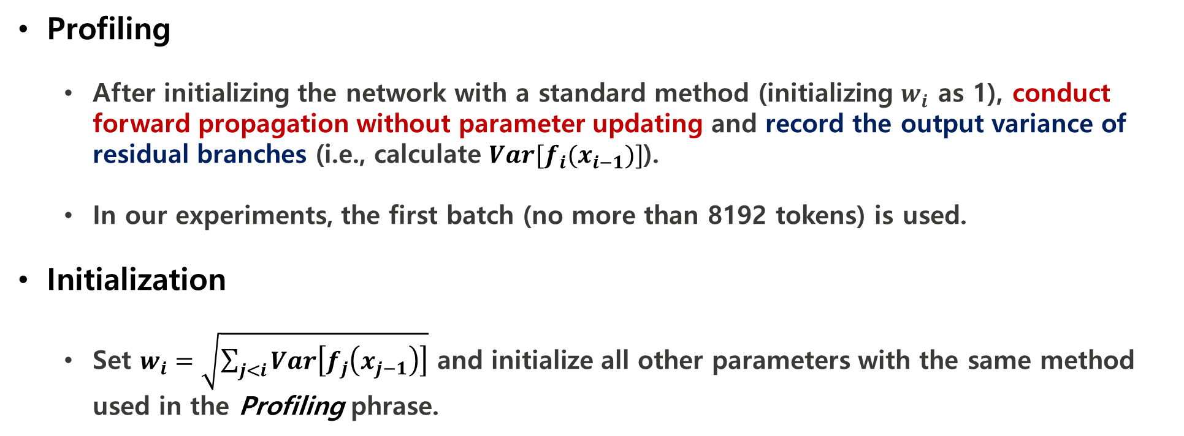
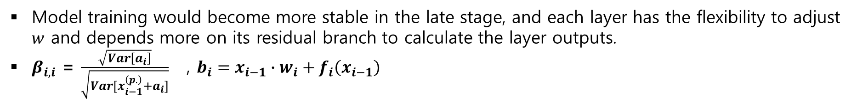
Part 4.3
Admin – Adaptive Model Initialization
Profiling
After initializing the network with a standard method (initializing $w_{i}$ as 1), conduct forward propagation without parameter updating and record the output variance of residual branches (i.e., calculate $Var[f_{i}(x_{i−1})]$).
In our experiments, the first batch (no more than 8192 tokens) is used.
Initialization
Set $w_{i}=\sqrt{\sum_{j<i}{Var\left[f_{j}\left(x_{j−1}\right)\right]}}$ and initialize all other parameters with the same method used in the Profiling phrase.
Model training would become more stable in the late stage, and each layer has the flexibility to adjust $w$ and depends more on its residual branch to calculate the layer outputs.
$β_{i,i}$ = $\frac{\sqrt{Var\left[a_{i}\right]}}{\sqrt{Var[x_{i−1}^{\left(p.\right)}+a_{i}]}}$ , $b_{i}=x_{i−1}∙w_{i}+f_{i}\left(x_{i−1}\right)$

Slide 25
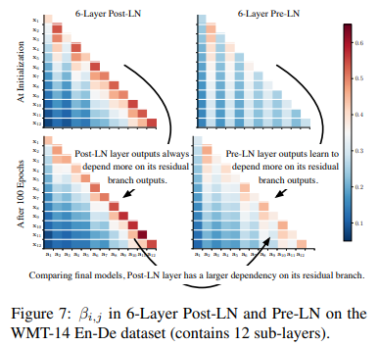
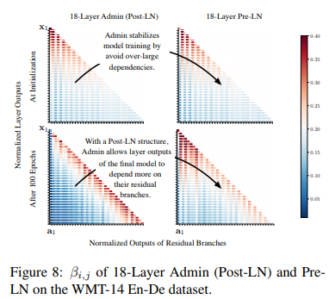
Part 4.3
Admin – Adaptive Model Initialization
To verify our intuition, we calculate the layer dependency of 18-Layer models and visualize the result in Figure 8.

Slide 26
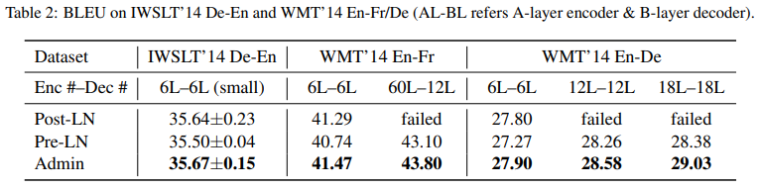
Part 4.3
Admin – Adaptive Model Initialization
Although Admin is formulated in a Post-LN manner and suffers from gradient vanishing, 18-layer Admin successfully converges and outperforms 18-layer Pre-LN
This evidence supports our intuition that the large dependency on residual branches amplifies the output fluctuation and destabilizes training.
결국 residual branches의 큰 의존성이 output 변동을 증폭시킴! -> 학습 불안정

Slide 27
Experiments
김봉민

Slide 28
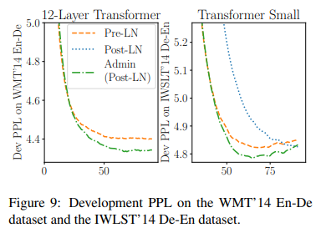
Part 5
Experiments
Although the 6-layer Pre-LN converges faster than Post-LN, its final performance is worse than Post-LN.
In contrast, Admin not only achieves the same convergence speed with Pre-LN in the early stage but reaches a good performance in the late stage.

Slide 29
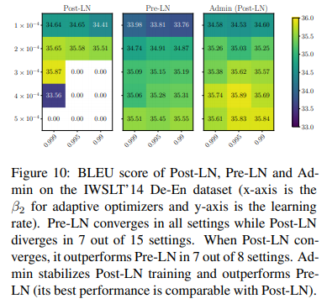
Part 5
Experiments
Admin outperforms the other two by a small margin.
As in Table 2, our method achieves a BLEU score of 43.8 on the WMT’14 En-Fr dataset, the new state-of-the-art.

Slide 30
Conclusion
김봉민

Slide 31
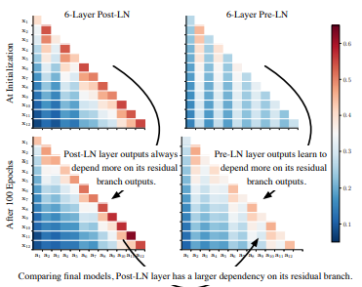
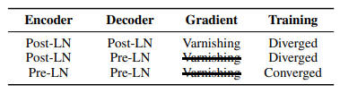
Part 6
Conclusion
In this paper, we study the difficulties of training Transformers.
Section 3 suggests that the gradient vanishing problem is not the root cause of unstable Transformer training.
Section 4 we reveal the root cause of the instability to be the strong dependency on residual branches.
Admin controls the dependency at the beginning of training and maintains the flexibility to capture those dependencies once training stabilizes.
Extensive experiments verify our intuitions and show that, without introducing additional hyper-parameters, Admin achieves more stable training, faster convergence, and better performance.
Section 3
Section 4

